Slide 1


NVME Over Fabrics Senior Design Project May 25, 2016
Team Members:
John Gemignani
Coy Humphrey
Eric Litvinsky
Jayden Navarro
Alice Yu

Slide 2
Problem Statement
Company X has a need to measure the atmospheric density in Tahiti.
We are building a portable sensor suite including atmospheric density suited for humid climate.
Supporting Figures

Slide 3
Project Goals
Assemble a functional protocol stack
Benchmark the functional protocol stack
Create a custom test suite
Will determine read, write, buffer size, and seek performance

Slide 4
Our Approach
What was the first step?
Then what did you do?
Any important details?
What does the final product look like?

Slide 5
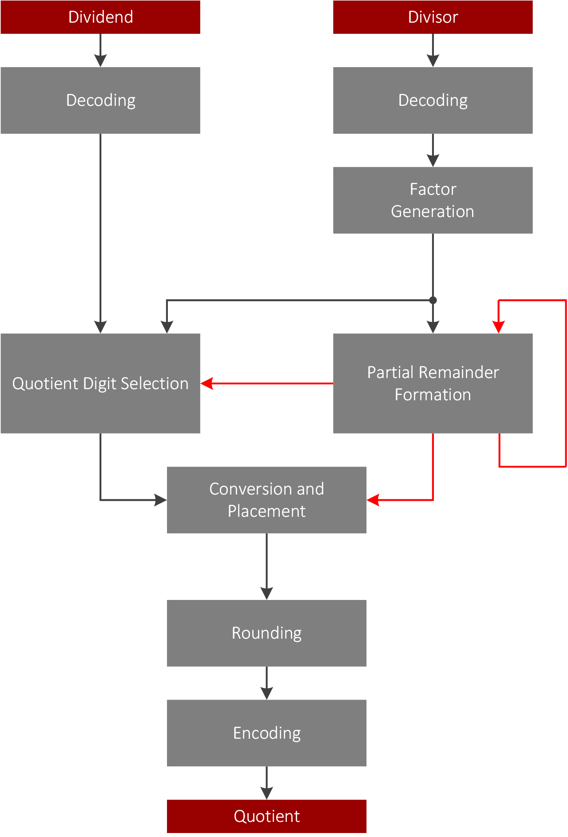
1
Implementation details
Detail 1
Detail 2
Detail 3
Detail 4
Supporting Figures
Change this slide as necessary

Slide 6
Implementation details
Detail 1
Detail 2
Detail 3
Detail 4
2
Supporting Figures
Change this slide as necessary

Slide 7
Results
Show graphs or other graphical indicators of a completed job.
Highlight in text your three main accomplishments.
Propose any future work or open questions that your work has raised.

Slide 8
Thanks to
Samuel Fineberg, Ph.D., Distinguished Technologist, Storage Chief Technologist Office at Hewlett Packard Enterprise
Dr. Linda Werner, Ph.D., Faculty Advisor, UCSC
Daniel Fava, Graduate Teaching Assistant, UCSC
Kevin Cheng for participating in the first half of the project
HPE for the hardware and support provided

